Slide 1
Design and Analysis of Three-Phase Inverter for Electric Vehicles
B.TECH. PROJECT - I
EE-493
Supervisor:- Prof. Vinod Kumar Bussa
Presenter - Priya Raj(2001EE46)

Slide 2

WHY ANALYSIS OF three phase inverters???
An inverter circuit made it possible to convert DC power into AC power of required frequency and voltage.
Three phase inverters are widely used to control different industrial process (electric and hybrid electric vehicles, high-frequency induction heating applications, etc) as they are very popular for fast response and precise control.
Electric vehicles are increasingly being considered for sustainable and environment friendly transportation. The performance of these vehicles largely depends on the power electronics inverters, which are used to drive the traction motor which is generally fed by battery.

Slide 3
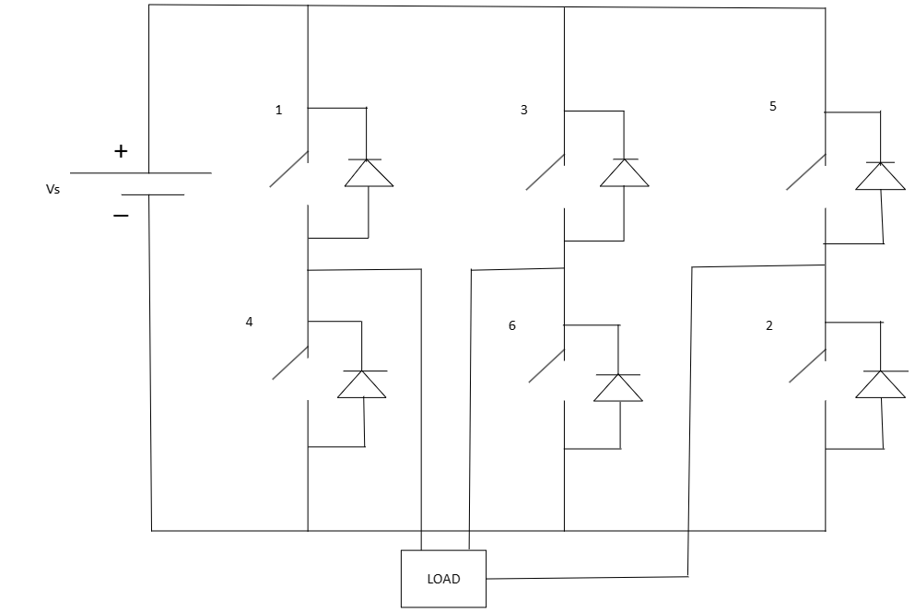
Circuit diagram for three phase inverter:-

Slide 4
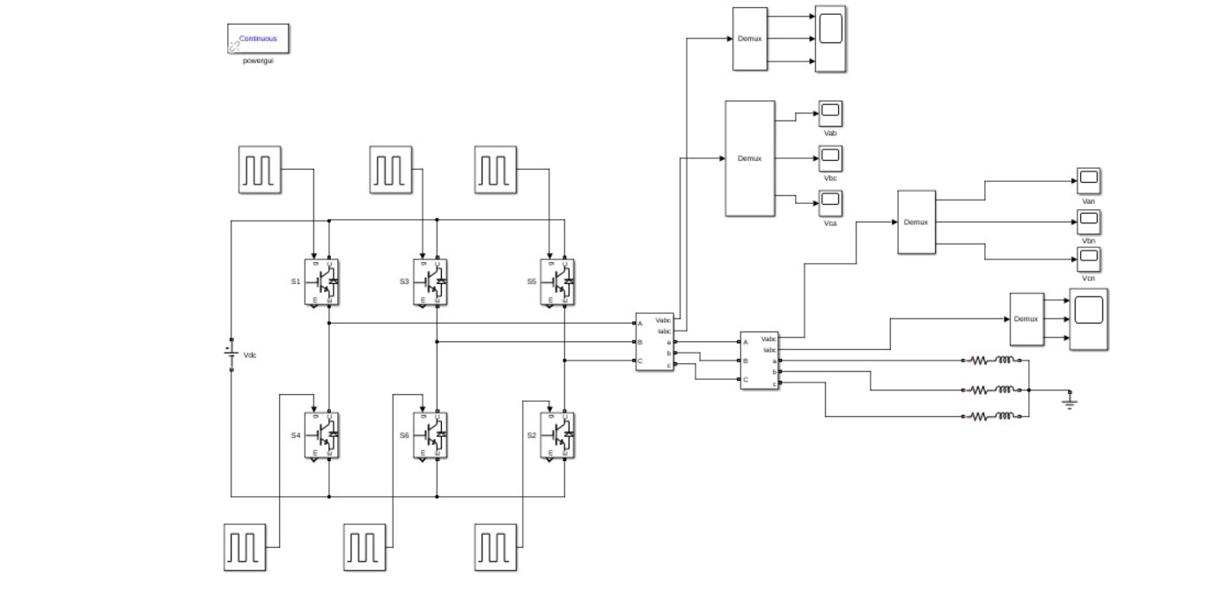
Design of 3- phase inverter using 180° conduction mode

Slide 5
Design of 3- phase inverter using 180° conduction mode
Case 1 (for 0 - 60°):- Switch S1, S5, and S6 will conduct
Z_{eq} = Z + Z/2 = 3Z/2
i₁ = V_{s}/Z_{eq} = 2V_{s}/3Z
v_{an} = v_{cn} = i₁Z/2 = V_{s}/3
v_{bn} = -i₁Z = -2V_{s}/3
Case 2 (for 60° - 120°):- Switch S1, S2, and S6 will conduct
Z_{eq} = Z + Z/2 = 3Z/2
i₂ = V_{s}/Z_{eq} = 2V_{s}/3Z
v_{bn} = v_{cn} = -i₂Z/2 = -V_{s}/3
v_{an} = i₂Z = 2V_{s}/3
Case 3 (for 120° - 180°):- Switch S1, S2, and S3 will conduct
Z_{eq} = Z + Z/2 = 3Z/2
i₃ = V_{s}/Z_{eq} = 2V_{s}/3Z
v_{an} = v_{bn} = i₃Z/2 = V_{s}/3
v_{cn} = -i₃Z = -2V_{s}/3

Slide 6
CALCULATION
Formula of Line and Phase Voltage:
RMS value of Line voltage V_{L} is given as below.
V_{L} = 0.8165V_{s}
RMS Value of phase voltage V_{p} is given as below:
V_{p} = 0.4714V_{s}
Here, we have provided a voltage of 440 V:
V_{L}(rms) = 0.8165*440 = 359.26 V
V_{P}(rms) = 0.4714*440 = 207.41 V

Slide 7
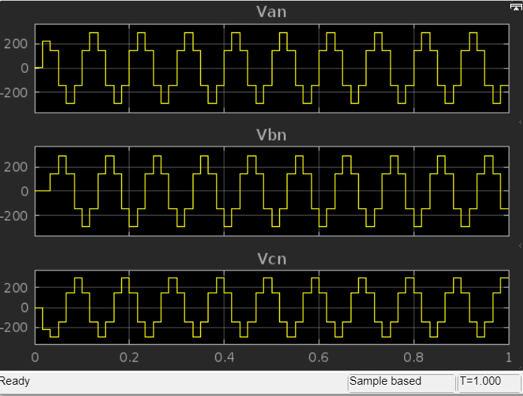
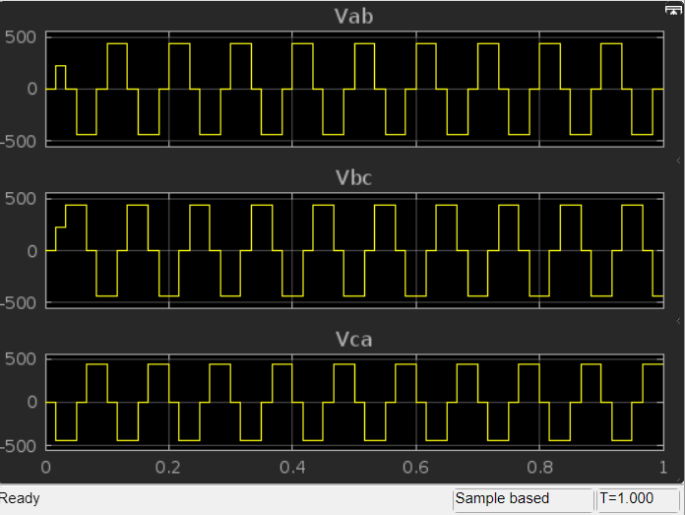
Output line and phase voltage waveforms:-
Waveform of phase voltage Waveform of line voltage

Slide 8
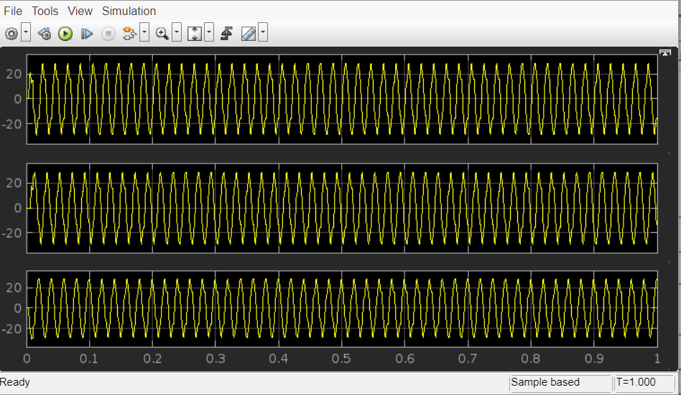
Output current waveforms:-
Waveforms of output currents (Iab, Ibc, and Ica)

Slide 9
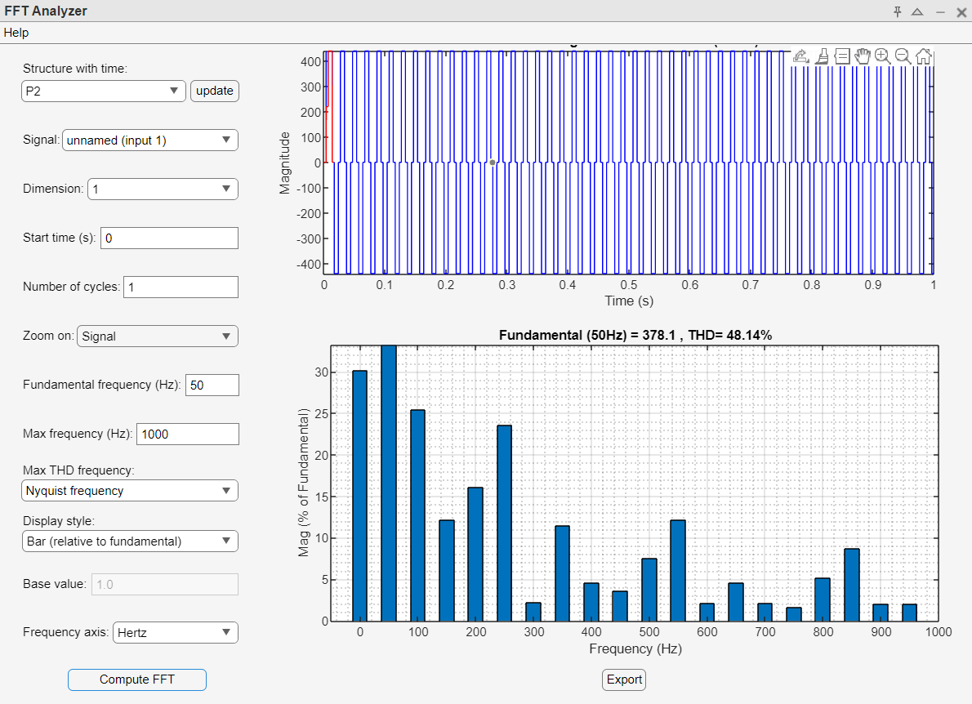
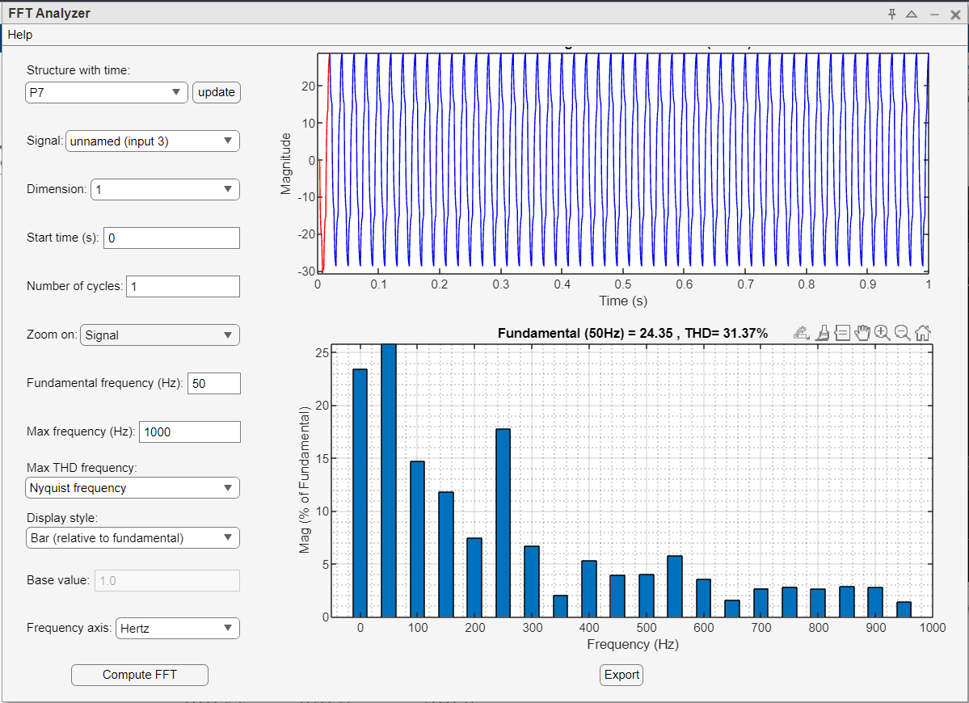
Thd analysis:-
Output voltage (Vbc) THD analysis Output current (Ica) THD analysis

Slide 10
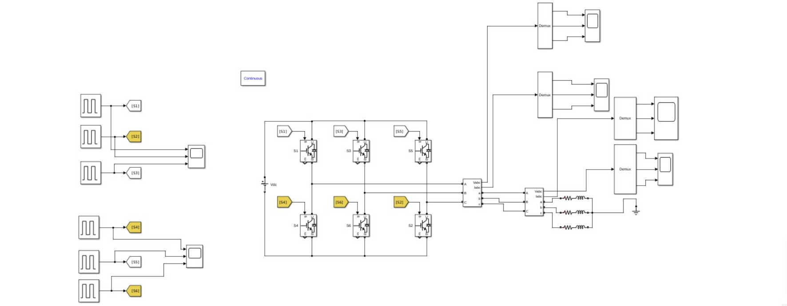
Design of 3- phase inverter using 120° conduction mode

Slide 11
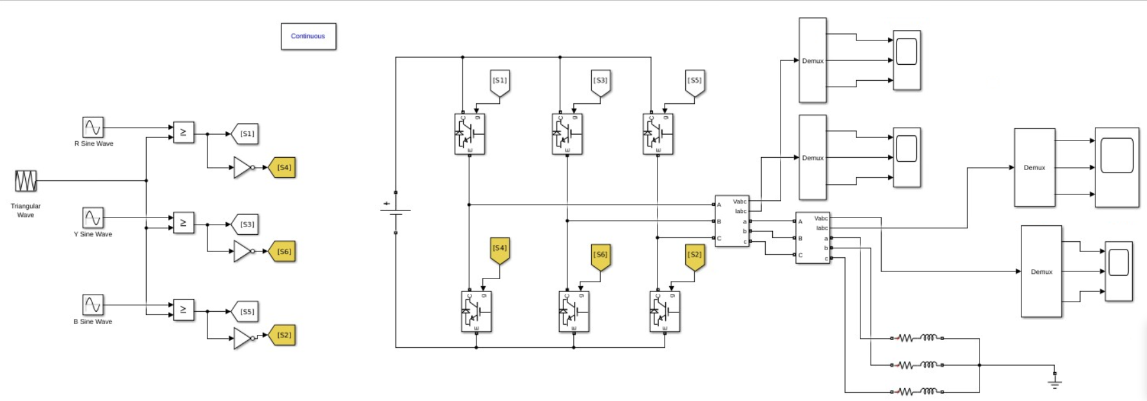
Design of 3- phase inverter using spwm method

Slide 12
CHARACTERISTIC TABLE:-
180° conduction mode | 120° conduction mode | SPWM method
RMS | THD(%) | RMS | THD(%) | RMS | THD(%)
Vab
Vbc
Vca
Van
Vbn
Vcn
Iab
Ibc
Ica
356.5 V | 53.37 | 330.6 V | 59.48 | 326.6 V | 43.69
357.6 V | 49.14 | 351.3 V | 57.60 | 324.9 V | 41.65
358.9 V | 51.55 | 330.1 V | 61.23 | 320.3 V | 43.87
206.6 V | 63.27 | 186.5 V | 58.66 | 186.6 V | 45.96
205.8 V | 63.12 | 199.0 V | 61.48 | 189.6 V | 44.78
207.2 V | 62.11 | 198.7 V | 57.61 | 186.8 V | 45.82
18.81 A | 25.14 | 16.19 A | 52.67 | 16.42 A | 19.39
18.77 A | 28.58 | 15.97 A | 54.85 | 16.29 A | 21.84
18.87 A | 29.37 | 16.8 A | 56.61 | 15.68 A | 20.99

Slide 13
conclusion:-
After generating the output wave shapes from the inverter has been compared to theoretical wave shapes to verify the inverter is functional as expected.
Among 180°, 120° conduction mode and SPWM method, the SPWM gives a better result in sense of the wave shape of the voltage generated by the inverter.
This method resembles a shape which is very similar to a sinusoidal waveform. Whereas waveform of the 180° and 120° have more likely to a square wave.
SPWM method has less harmonic distortion compared to the other two conduction modes.

Slide 14
FUTURE WORK:-
Till now I have not used any filter in any conduction mode. So, in future I will use some basic LC filter to get better output voltage and current waveforms (i.e. sine wave output waveforms).
Till now I have done the open loop analysis further, I will try to analyze the closed loop analysis.
Circuit simulation (to generate pulse and for analysis of different modes) is done on MATLAB Simulink Software. Later, some sort of hardware work will also be tried to get it done finally.

Slide 15


